Slide 1
Delivering value continuously with Azure DevOps
Paul Hacker & Mitch Denny
TechBash 2018

Slide 2




Azure DevOps
#AzureDevOps
https://azure.com/devops
@AzureDevOps
https://aka.ms/AzureDevOpsForum
https://aka.ms/DevOpsBlog/
Notes:
Join the conversation.
Potentially replace for speaker contact details / intro.

Slide 3
Who are we?
Paul Hacker
https://paulhacker.net
@pjhacker
paul.hacker@microsoft.com
Notes:
Join the conversation.
Potentially replace for speaker contact details / intro.

Slide 4
Who are we?
Mitch Denny
https://mitchdenny.com
@mitchdenny
midenn@microsoft.com
Notes:
Join the conversation.
Potentially replace for speaker contact details / intro.

Slide 5
Who are you?
Help us help you!
What do you want to get out of this workshop?
Where are you on your DevOps journey?
What do you work on?
Notes:
Join the conversation.
Potentially replace for speaker contact details / intro.

Slide 6
What is DevOps?
People. Process. Products.
Build& Test
Deploy
DevOps is the union of people, process, and products to enable continuous delivery of value to your end users.
“
Continuous Delivery
Develop
Operate
”
Plan & Track
Monitor & Learn
Notes:
DevOps is the union of people, process and products to enable the continuous delivery of value to your end customers

Slide 7


High Performance DevOps Companies Achieve…
46x Deployment
Frequency
2,555x Faster Lead
Time For Changes
Faster
Time to Market
DevOps
$
Increased
Revenue
7x Lower Change
Failure Rate
2,604x Faster Mean
Time to Recover
Source: 2018 Accelerate: State of DevOps: Strategies for a New Economy." N. Forsgren, J. Humble, G. Kim. DevOps Research and Assessment (DORA)

Slide 8

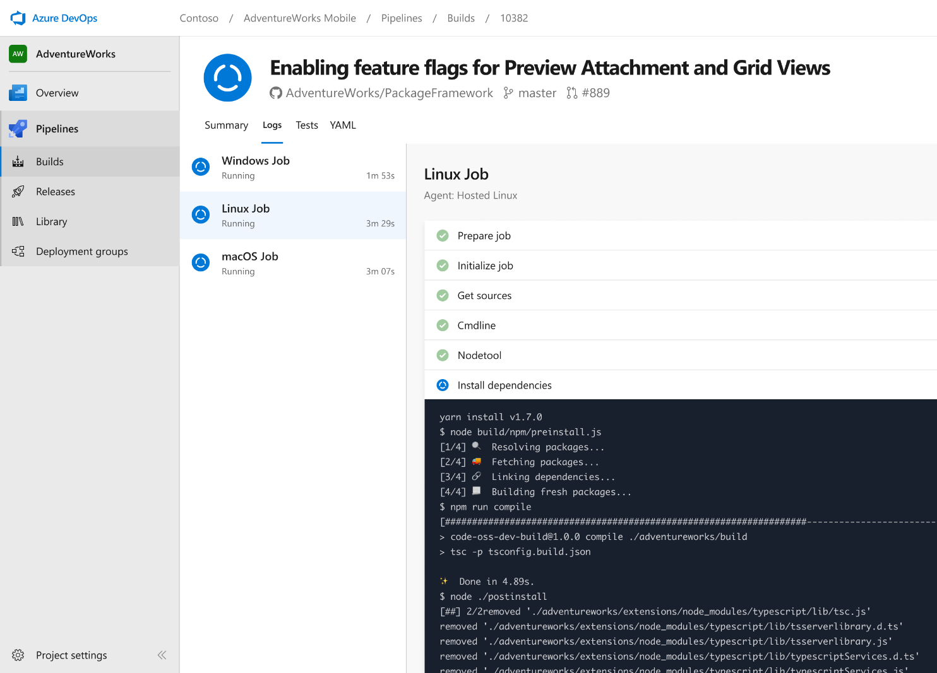


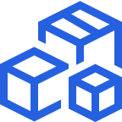

Azure Pipelines
Cloud-hosted pipelines for Linux, Windows and macOS, with unlimited minutes for open source
Any language, any platform, any cloud
Build, test, and deploy Node.js, Python, Java, PHP, Ruby, C/C++, .NET, Android, and iOS apps. Run in parallel on Linux, macOS, and Windows. Deploy to Azure, AWS, GCP or on-premises
Extensible
Explore and implement a wide range of community-built build, test, and deployment tasks, along with hundreds of extensions from Slack to SonarCloud. Support for YAML, reporting and more
Containers and Kubernetes
Easily build and push images to container registries like Docker Hub and Azure Container Registry. Deploy containers to individual hosts or Kubernetes.
Best-in-class for open source
Ensure fast continuous integration/continuous delivery (CI/CD) pipelines for every open source project. Get unlimited build minutes for all open source projects with up to 10 free parallel jobs across Linux, macOS and Windows
➔
https://azure.com/pipelines
Notes:
Azure Pipelines is the perfect launchpad for your code – automating your builds and deployments so you spend less time with the nuts and bolts and more time being creative

Slide 9

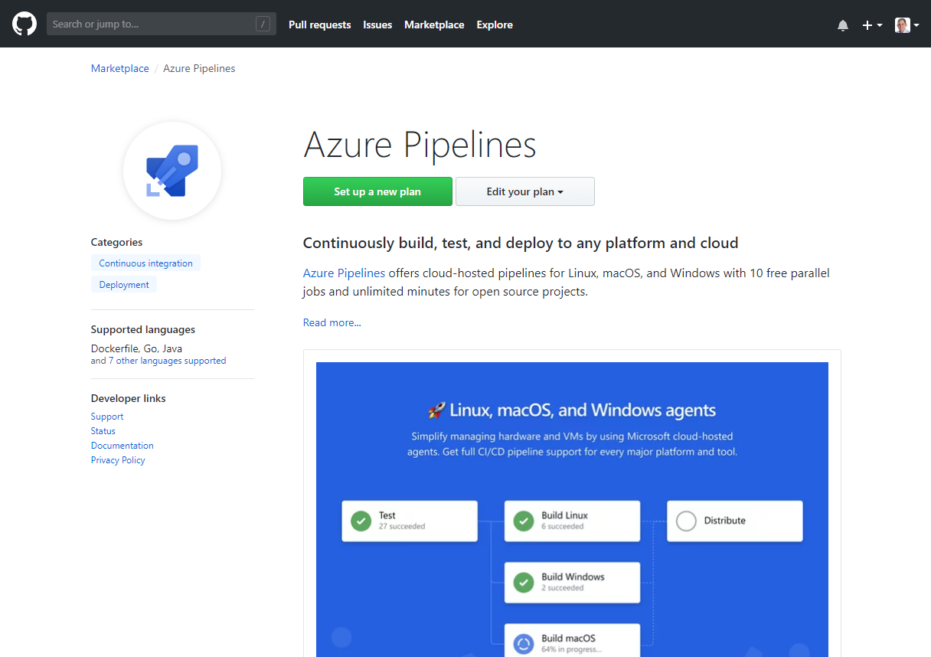
Integrated with GitHub
Azure Pipelines available now to any developer from the GitHub Marketplace

Slide 10

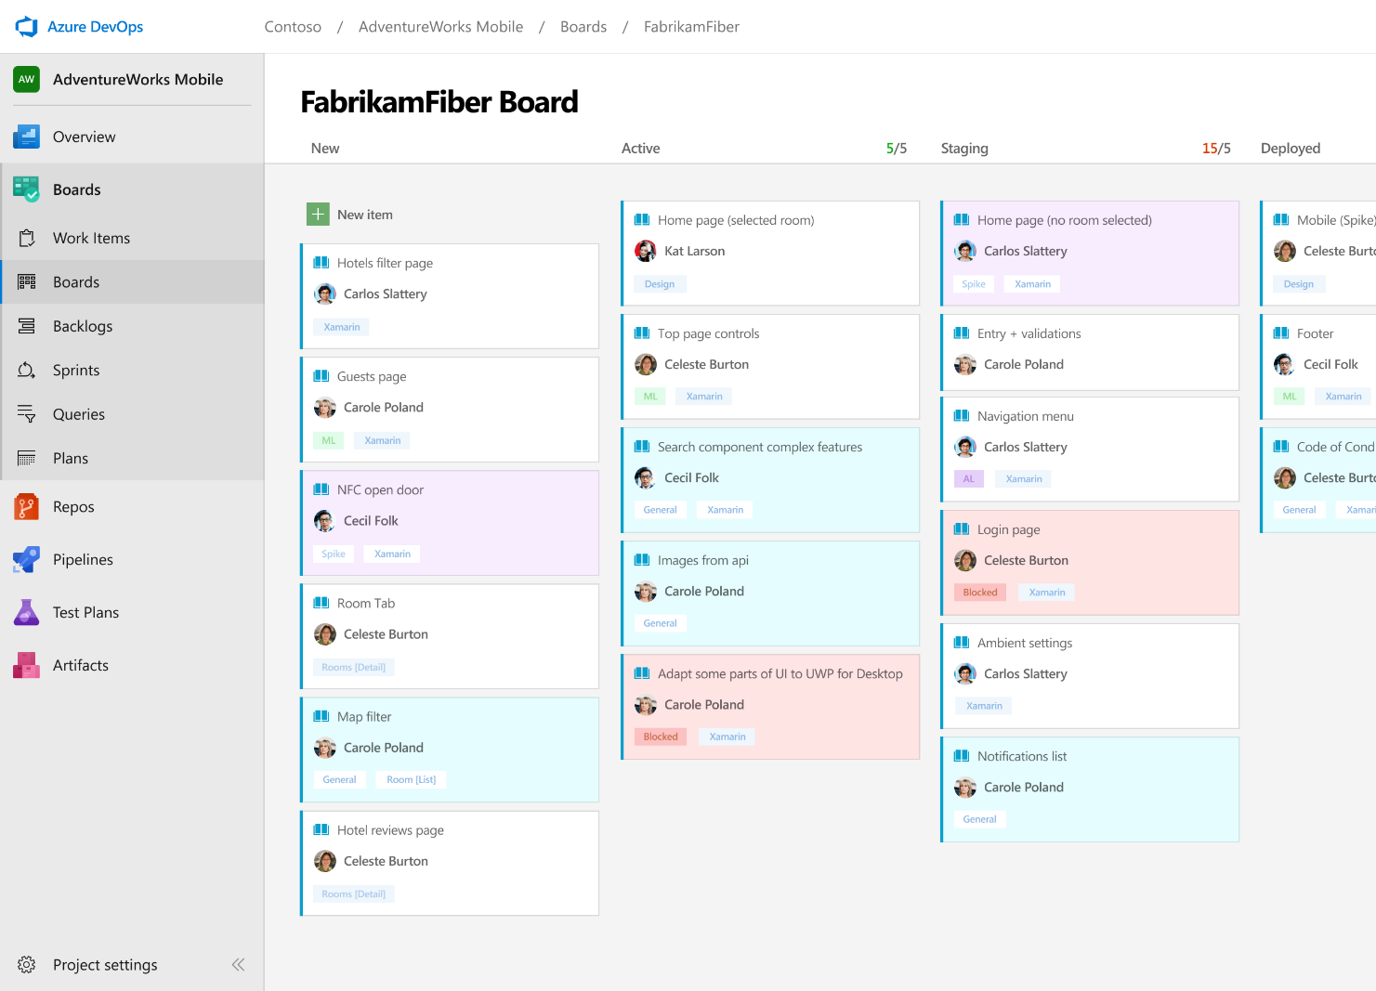



Azure Boards
Track work with Kanban boards, backlogs, team dashboards, and custom reporting
Connected from idea to release
Track all your ideas at every development stage and keep your team aligned with all code changes linked directly to work items.
Scrum ready
Use built-in scrum boards and planning tools to help your teams run sprints, stand-ups, and planning meetings.
Project insights
Gain new insights into the health and status of your project with powerful analytics tools and dashboard widgets.
➔
https://azure.com/devops
Notes:
Combine Kanban boards and drag-and-drop sprint planning with comprehensive traceability and reporting for the perfect home for all your ideas–big and small.

Slide 11
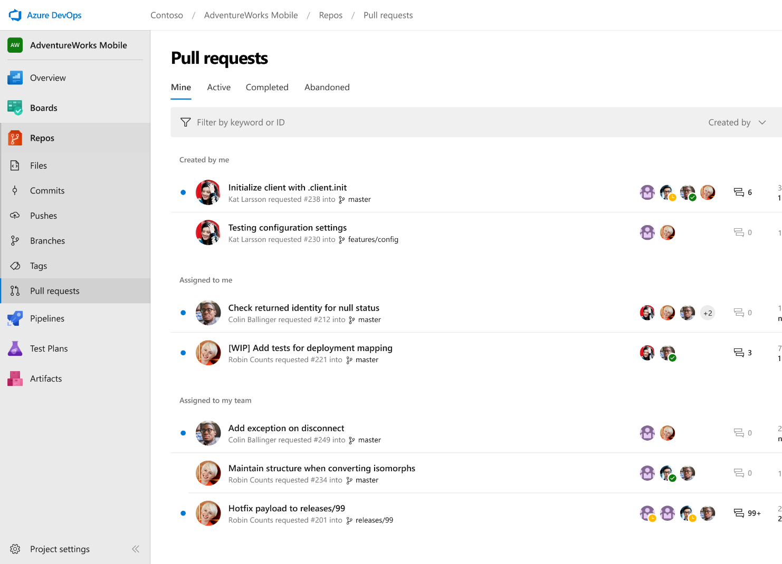



Azure Repos
Unlimited private Git repo hosting and support for TFVC that scales from a hobby project to the world’s largest Git repositories
Works with your Git client
Securely connect with and push code into your Git repos from any IDE, editor, or Git client.
Web hooks and API integration
Add validations and extensions from the marketplace or build your own using web hooks and REST APIs.
Semantic code search
Quickly find what you’re looking for with code-aware search that understands classes and variables.
➔
https://azure.com/devops
Notes:
Collaborate on code changes with threaded discussion and continuous integration for each change. Use forks to promote collaboration with Inner Source workflows.

Slide 12
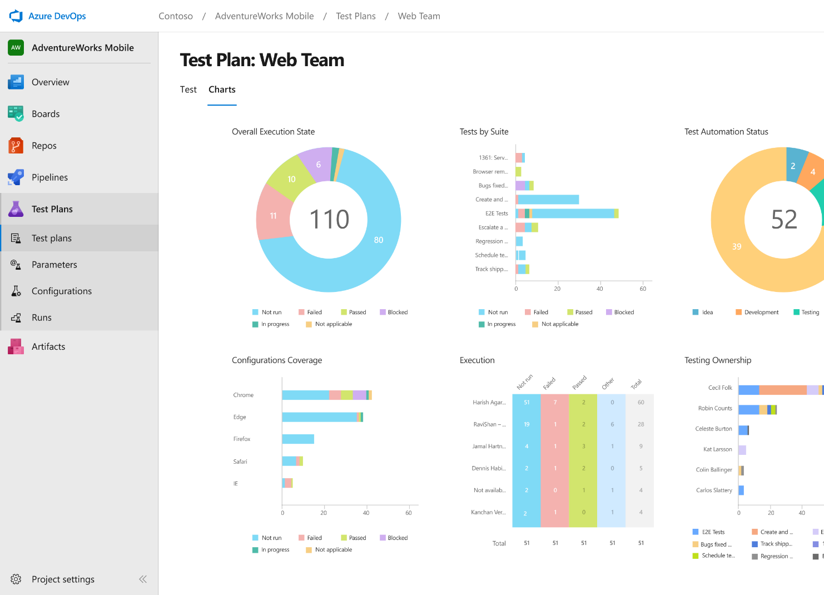
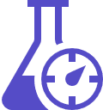


Azure Test Plans
Get end-to-end traceability. Run tests and log defects from your browser. Track and assess quality throughout your testing lifecycle.
Capture rich data
Capture rich scenario data as you execute tests to make discovered defects actionable. Explore user stories without test cases or test steps. You can create test cases directly from your exploratory test sessions.
Test across web and desktop
Test your application where it lives. Complete scripted tests across desktop or web scenarios. Test on-premises application from the cloud and vice-versa.
Get end-to-end traceability
Leverage the same test tools across your engineers and user acceptance testing stakeholders. Pay for the tools only when you need them.
➔
https://azure.com/devops
Notes:
Collaborate on code changes with threaded discussion and continuous integration for each change. Use forks to promote collaboration with Inner Source workflows.

Slide 13
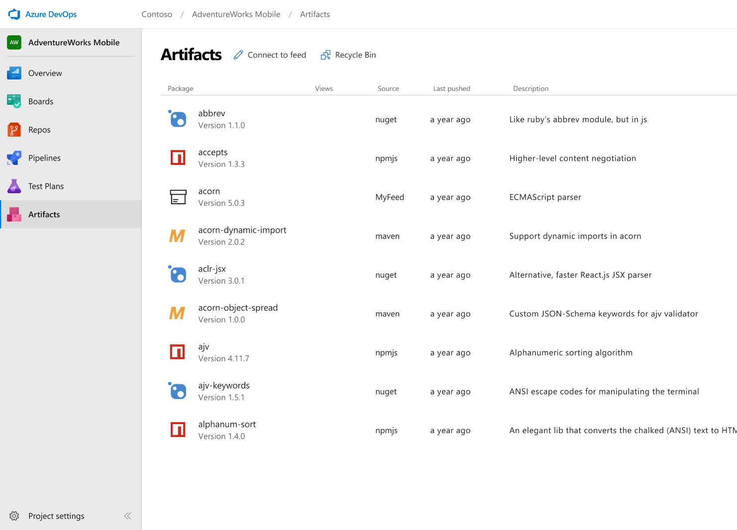



Azure Artifacts
Create and share Maven, npm, and NuGet package feeds from public and private sources – fully integrated into CI/CD pipelines
Manage all package types
Get universal artifact management for Maven, npm, and NuGet.
Add packages to any pipeline
Share packages, and use built-in CI/CD, versioning, and testing.
Share code efficiently
Easily share code across small teams and large enterprises.
➔
https://azure.com/devops
Notes:
Collaborate on code changes with threaded discussion and continuous integration for each change. Use forks to promote collaboration with Inner Source workflows.

Slide 14





Azure DevOps
Azure Boards
Azure Pipelines
Azure Repos
Deliver value to your users faster using proven agile tools to plan, track, and discuss work across your teams.
Build, test, and deploy with CI/CD that works with any language, platform, and cloud. Connect to GitHub or any other Git provider and deploy continuously.
Get unlimited, cloud-hosted private Git repos and collaborate to build better code with pull requests and advanced file management.
Azure Test Plans
Azure Artifacts
➔
Test and ship with confidence using manual and exploratory testing tools.
Create, host, and share packages with your team, and add artifacts to your CI/CD pipelines with a single click.
https://azure.com/devops
Notes:
So does TFS

Slide 15
Goals
Get you up and running with Azure DevOps
Track your work
Managing multiple environments
Create Continuous Integration (CI) builds
Create Continuous Delivery (CD) pipelines
Accelerate your delivery of value with Azure and Azure DevOps

Slide 16
Agenda for Today
Now
DevOps @ Microsoft
Morning
Planning exercise: Tailspin Toys
Afternoon
Hands-on Labs: Tailspin Toys
Parking Lot & Demos
Close
Final thoughts
1-on-1 time

Slide 17
Breaks
Yes, we’ll have some.
Morning Break
Lunch ~12
Afternoon Break

Slide 18
Resouces for Today
Virtual Machine:
Will Give Out IPs
Password: p3psiF1at46077
Azure Subscription:
BYO or Setup Free Trial: https://aka.ms/tbaztrial

